Slide 2
RUN 1
RUN 2
RUN 3
200 gen
50 gen
50 gen
50 gen
20 gen
20 gen
20 gen
20 gen
Whole Watershed
UP
MID
DOWN
A
B
C
D
Last Pareto
150 gen
40 gen
Whole Watershed
AUBUCUD
Last Pareto
140 gen
Whole Watershed
Last Pareto

Slide 3
RUN 1
RUN 2
RUN 3
Size of optimization domain
20 gen
20 gen
20 gen
20 gen
A
B
C
D
50 gen
50 gen
50 gen
40 gen
UP
MID
DOWN
AUBUCUD
200 gen
150 gen
140 gen
Whole Watershed
Whole Watershed
Whole Watershed
Last Pareto frontier
Last Pareto frontier
Last Pareto frontier

Slide 4
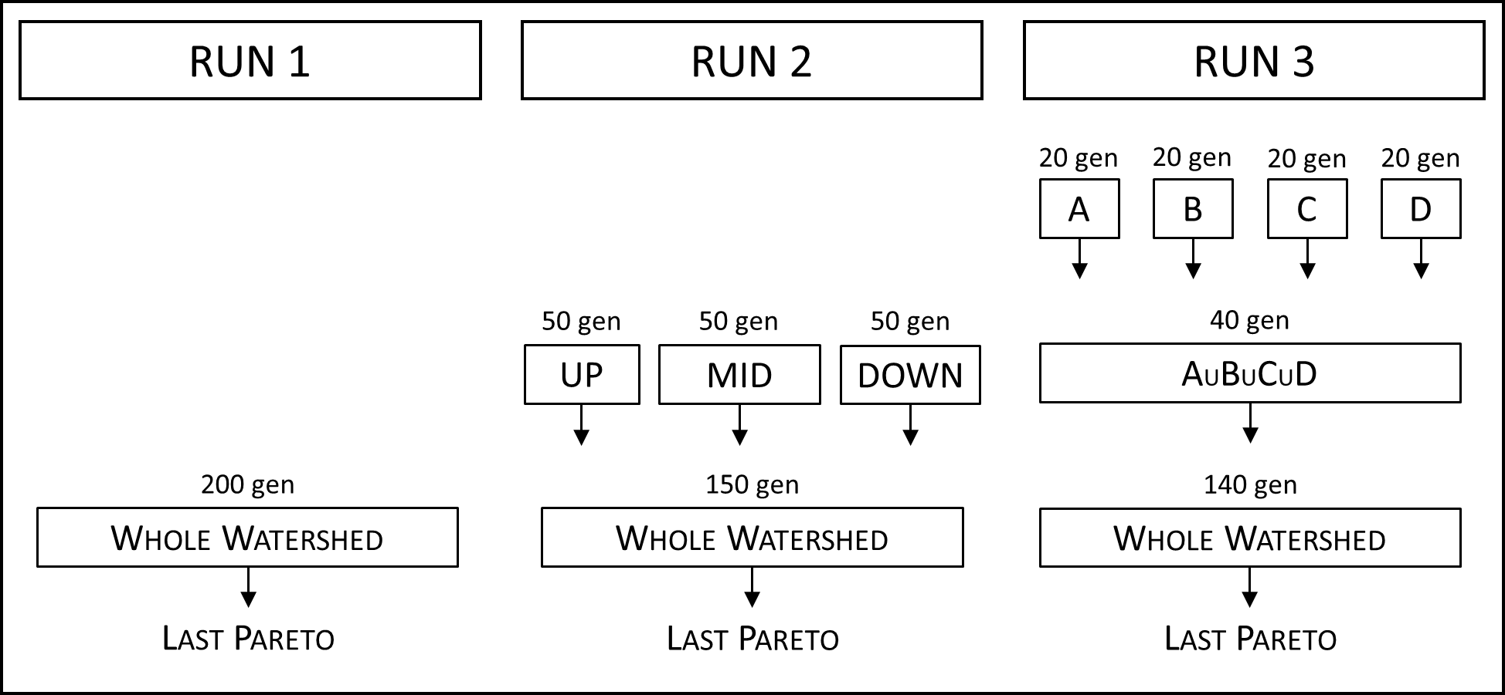

Slide 5
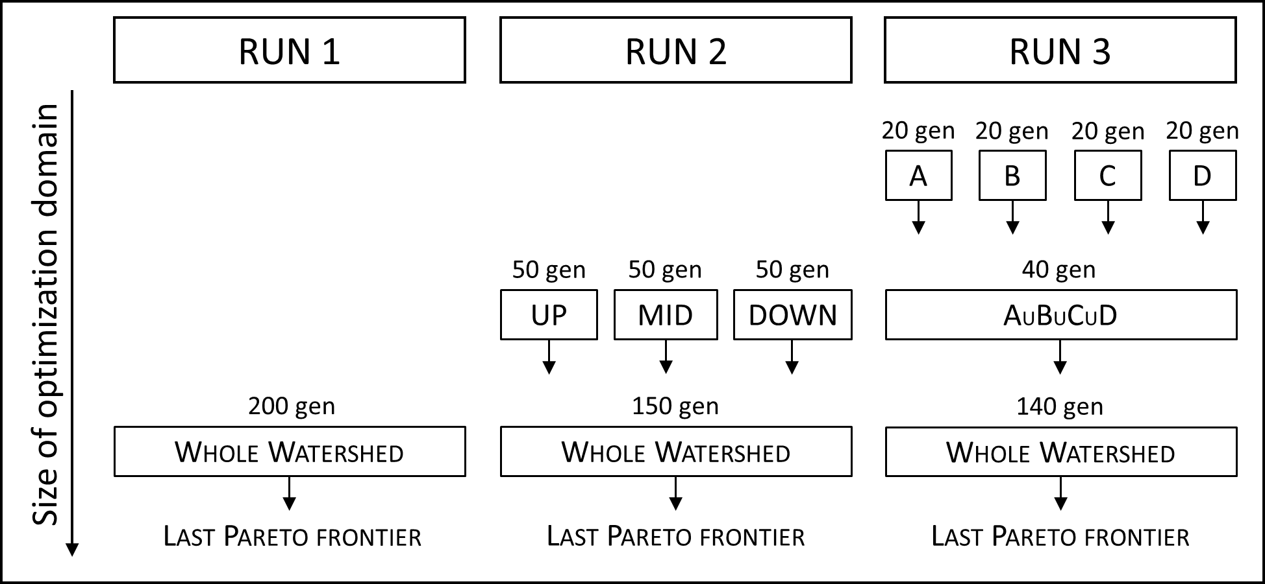

Slide 6
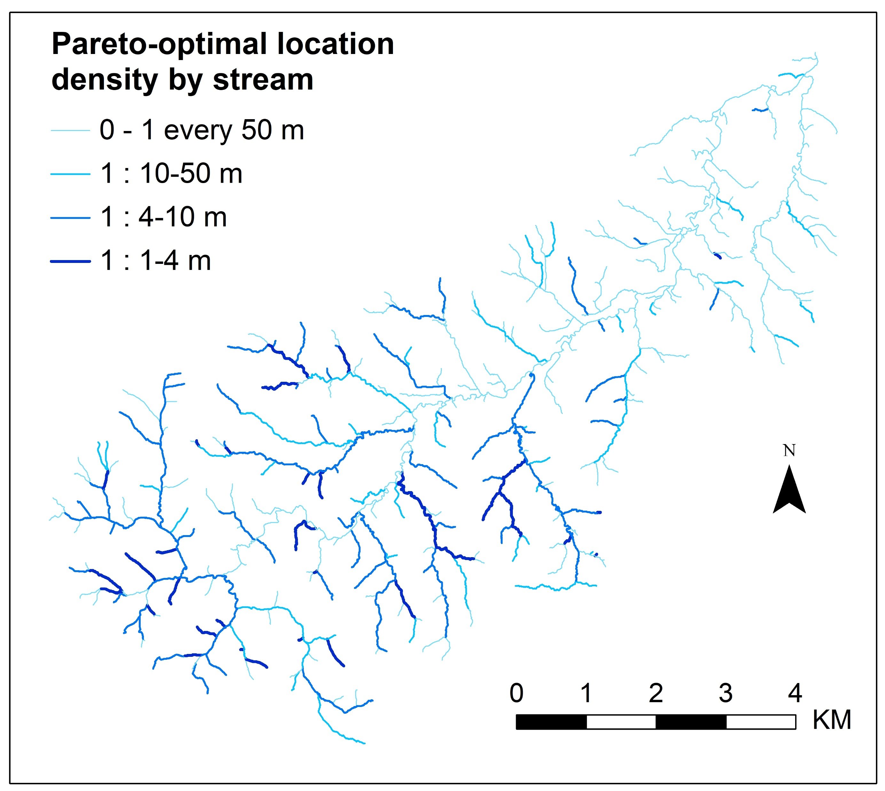
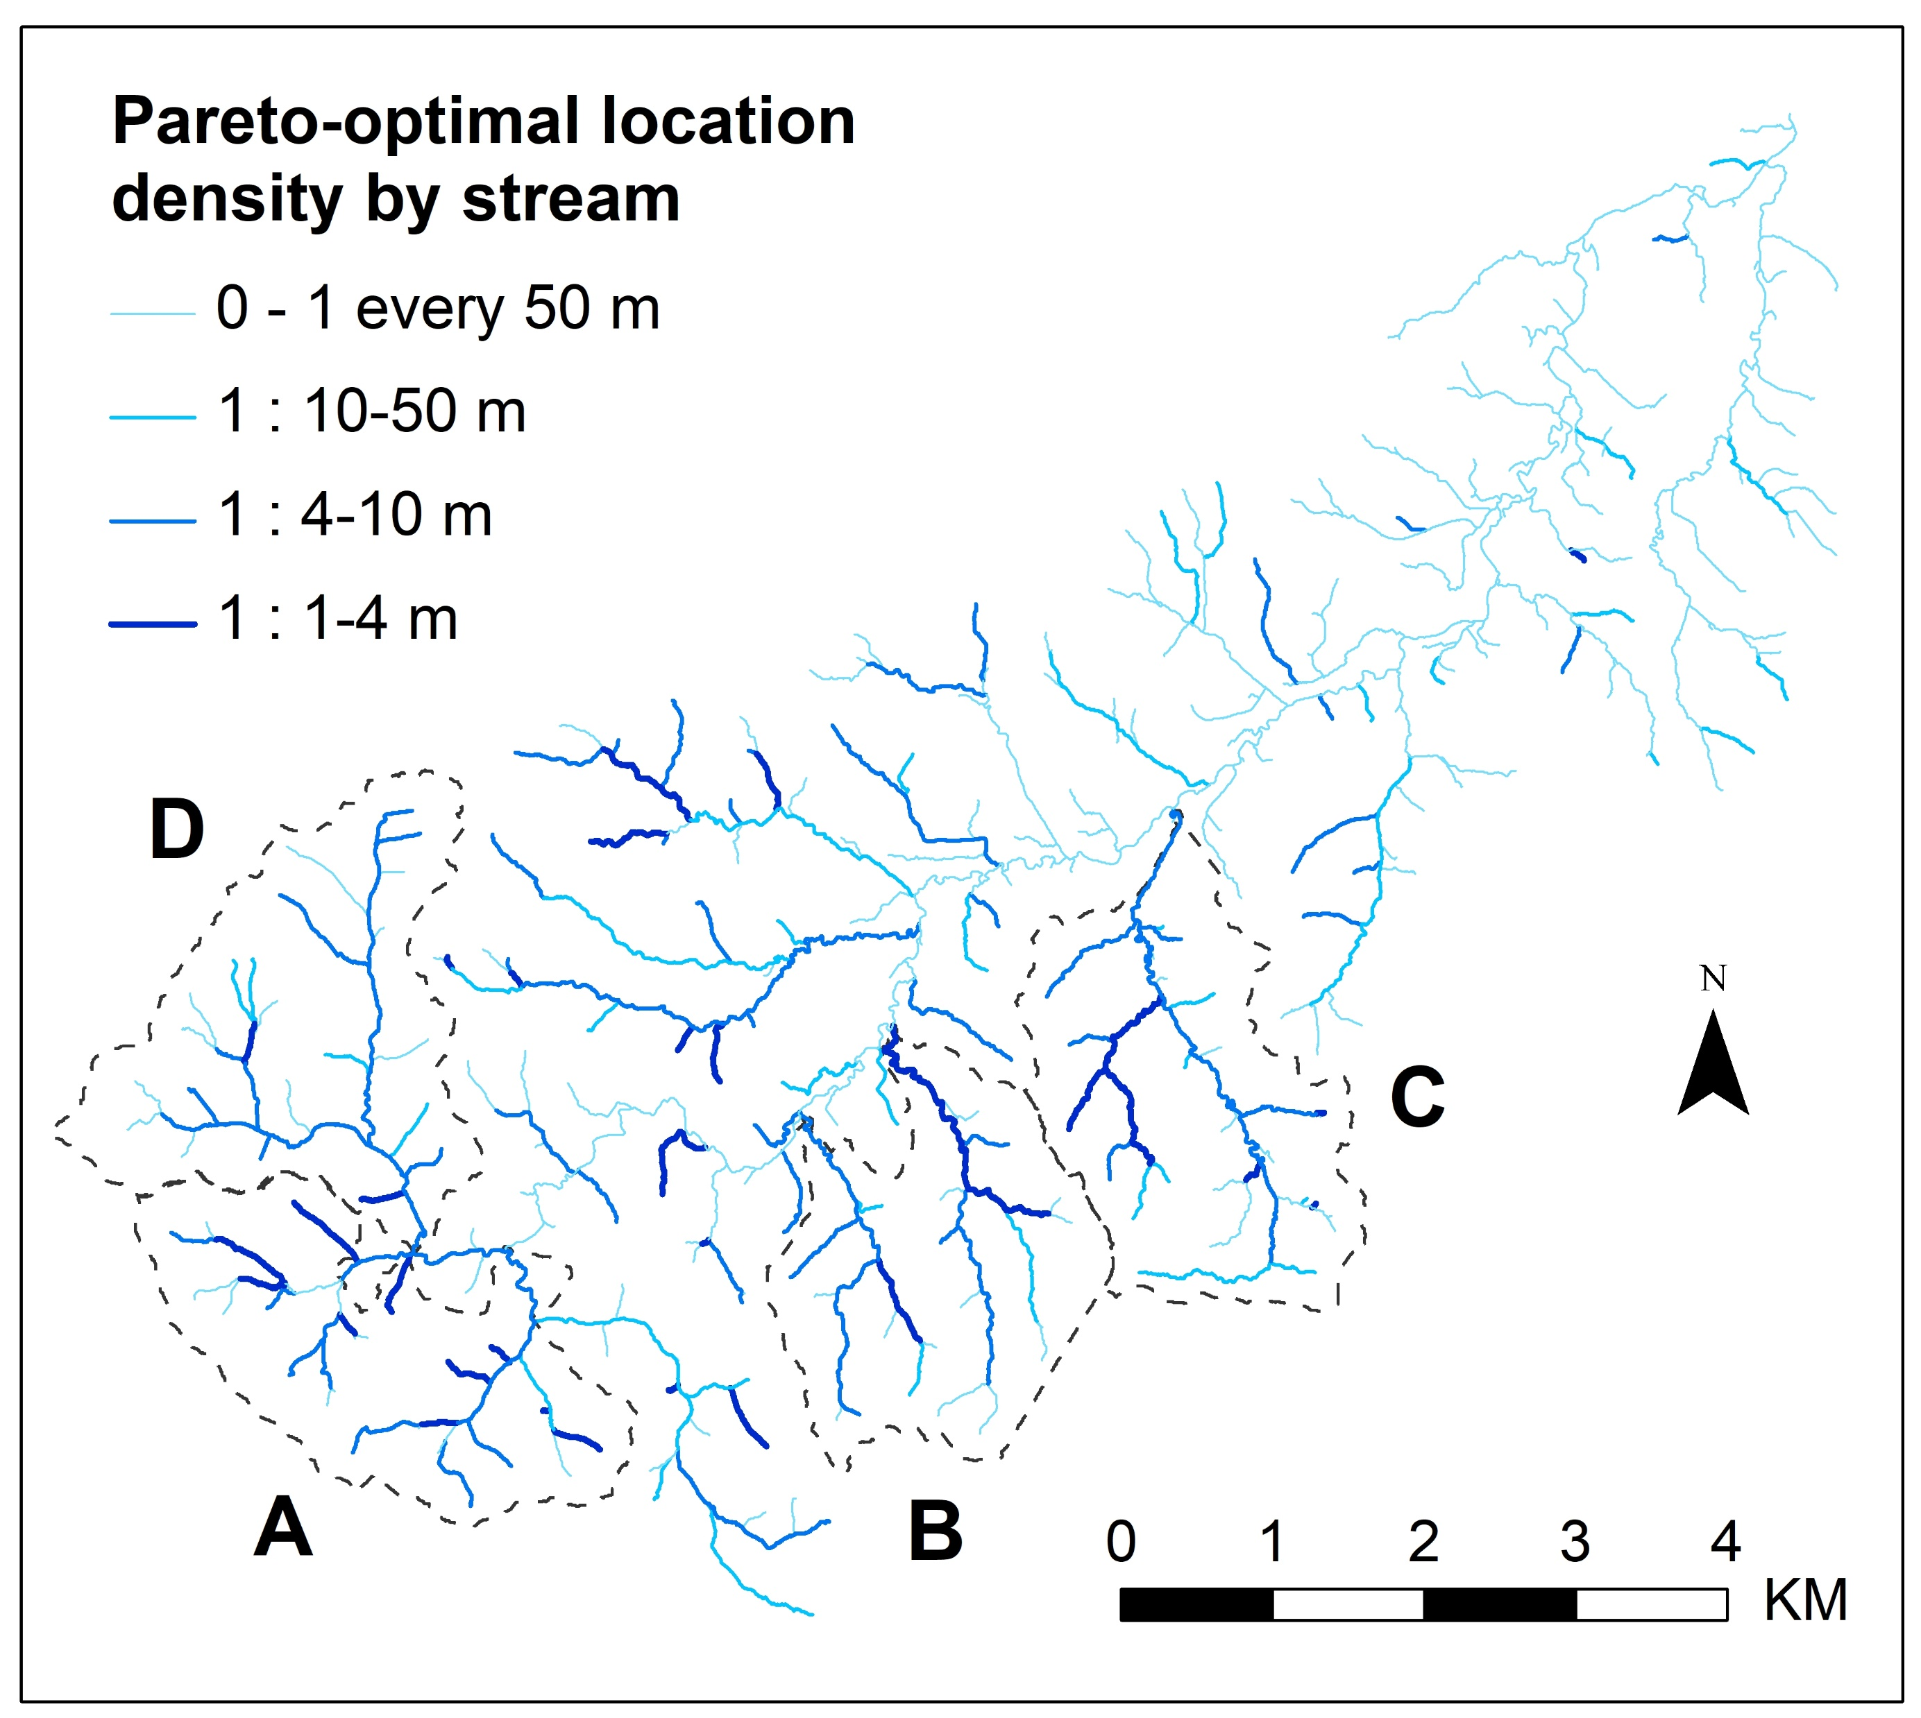
a
b

Slide 7
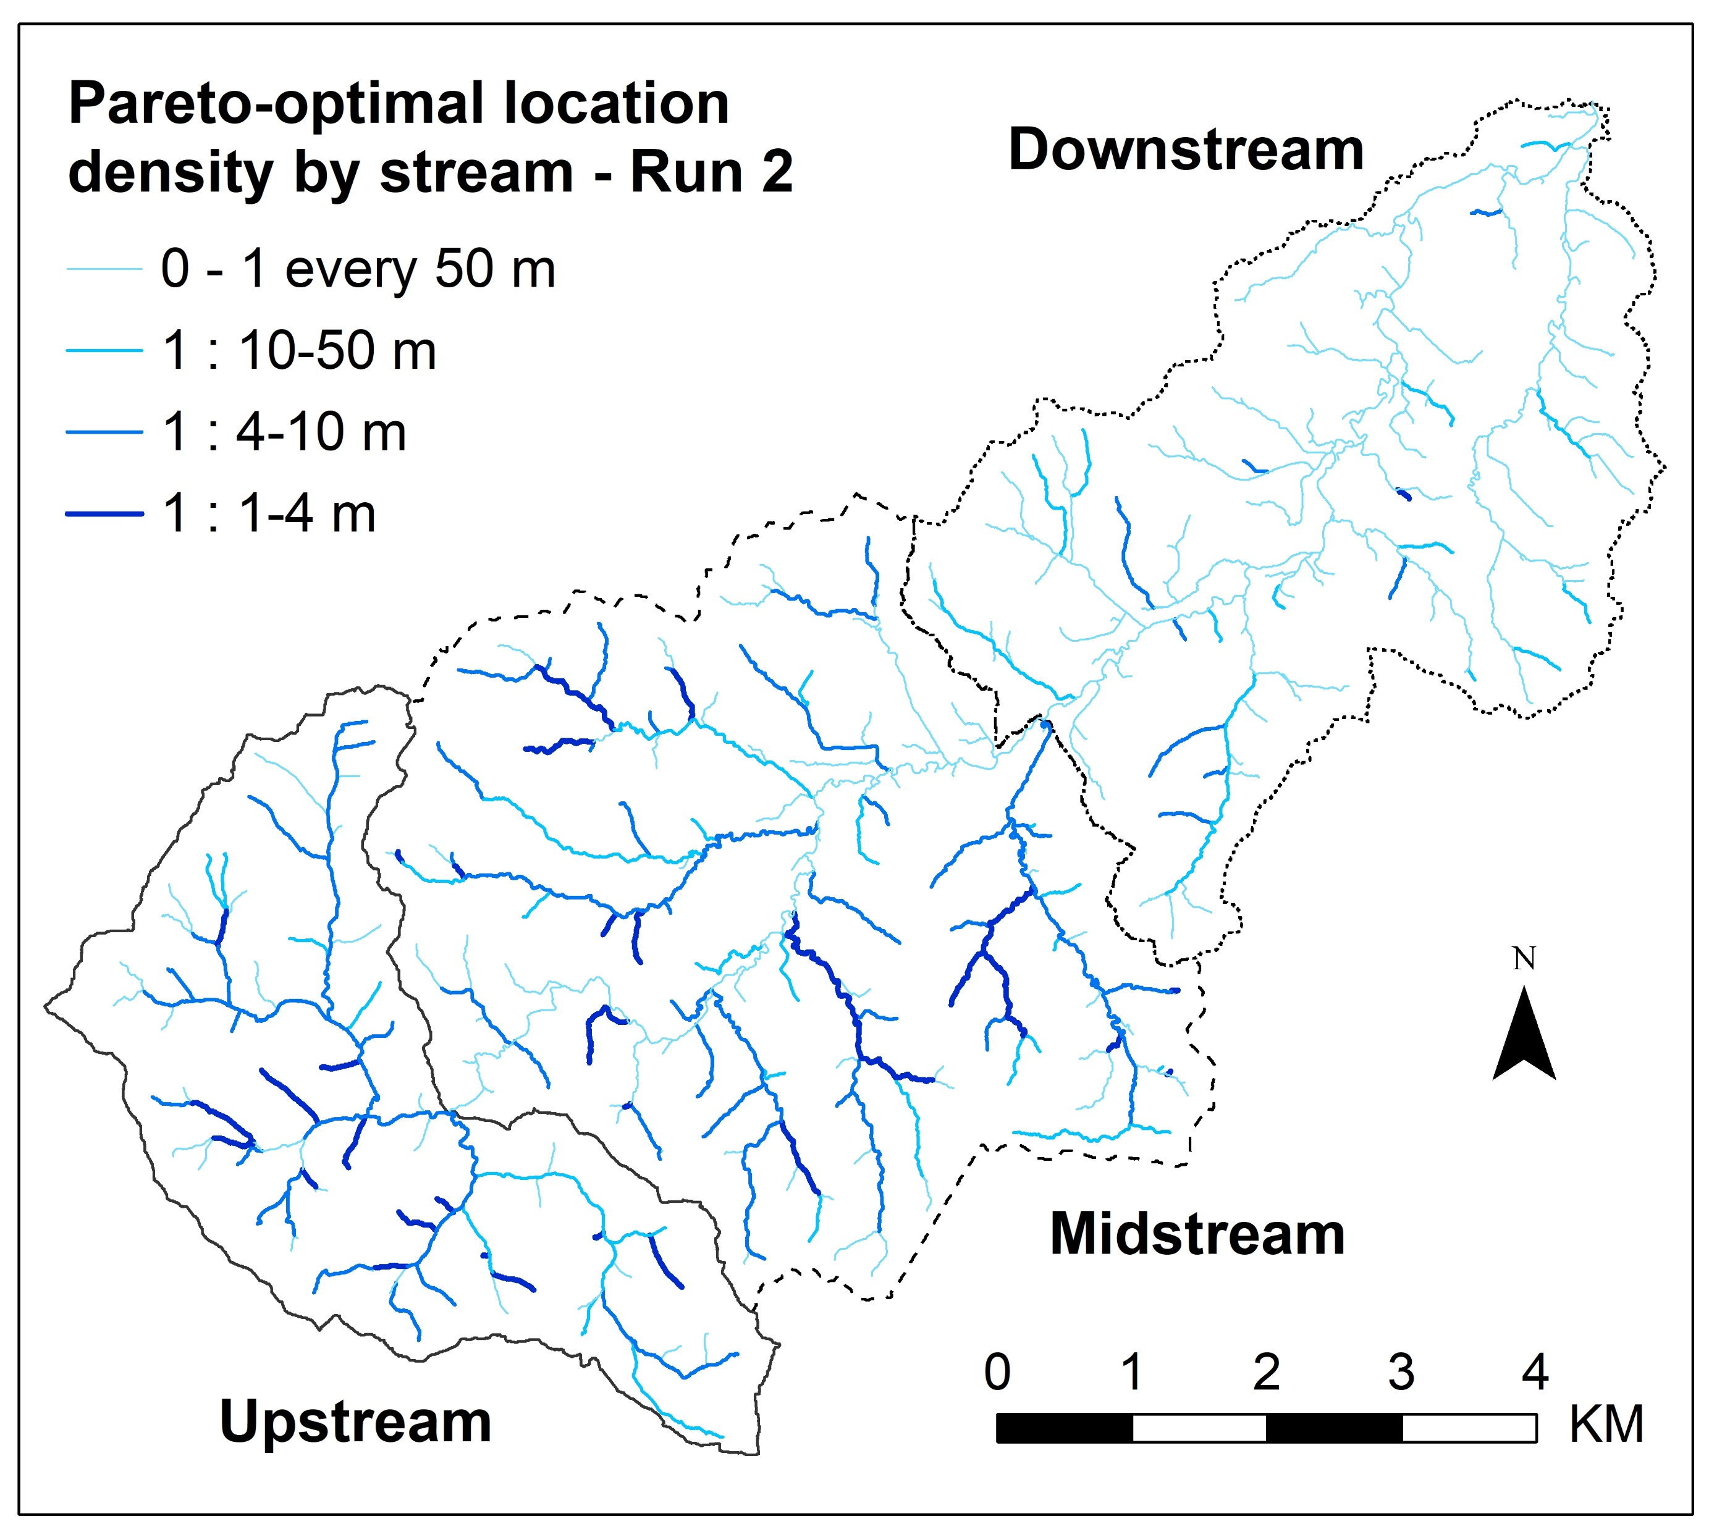
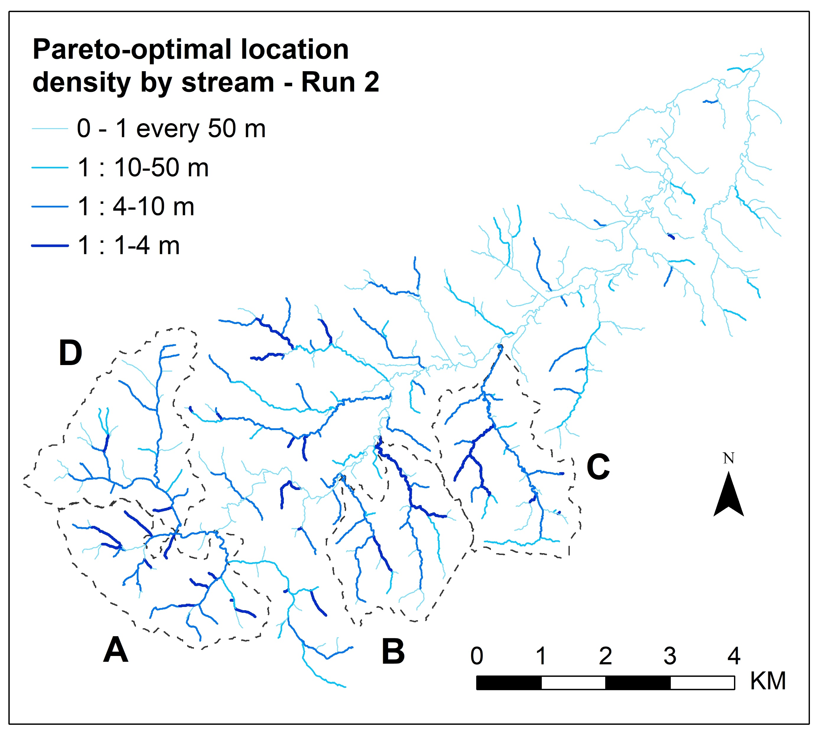
a
b

Slide 8
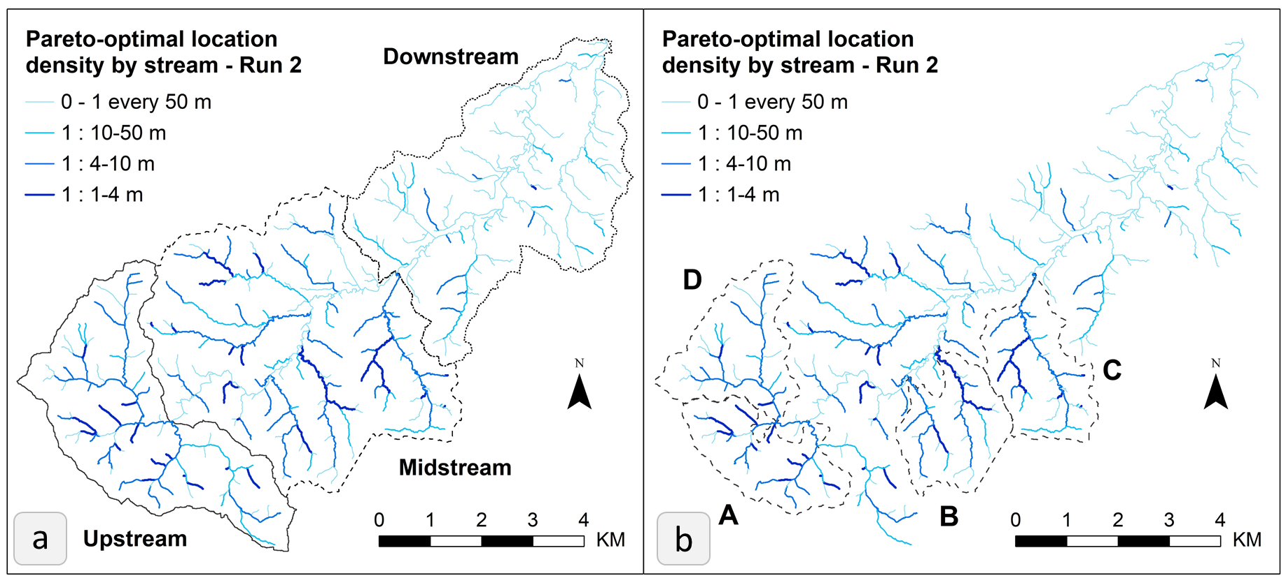

Slide 9
